Slide 1
Spring boot config

Slide 2
我是谁
黄家楷
88年
干过流水线、CRM、电商
2017.10加入客如云，订单交易中心的一名小猿

Slide 3
一.zk-config
二. configWacher
三. decrypt
四.local-config
五.Spring boot 初始化
目 录
CONTENTS

Slide 4
spring boot config
配置
本地配置
（ConfigFileApplicationListener）
外部配置
(PropertySourceBootstrapConfiguration)
bootstrap-{xxx}.properties
bootstrap.properties
zk
git

Slide 5
spring boot 外部配置
配置中心
服务A
服务B
服务A1
服务B1
服务A2
服务B2

Slide 6
一.zk-config

Slide 7
zk-config流程图
SpringApplication.run()
BootstrapConfiguration配置
PropertySourceBootstrapConfiguration. initialize()
PropertySourceLocator. Locate()
PropertySourceLocator. locate()
spring.factories
ZookeeperPropertySourceLocator.locate()
LocalPropertySourceLocator.locate()

Slide 8
zk-config 使用配置
spring: application: name: CalmRouter-trade profiles: active: ${profile.active} include: config,push,datasource,jedis,activemq,threadpool,security,trade_cfg
cloud: zookeeper: enabled: true config: enabled: true defaultContext: apps profileSeparator: ':' watcher: enabled: false security: key: wretched growth,don't indulge

Slide 9
zk-config里面的Spring.factories
# Auto Configuration org.springframework.boot.autoconfigure.EnableAutoConfiguration=\ org.springframework.cloud.zookeeper.config.ZookeeperConfigAutoConfiguration # Bootstrap Configuration org.springframework.cloud.bootstrap.BootstrapConfiguration=\ org.springframework.cloud.zookeeper.config.ZookeeperConfigBootstrapConfiguration

Slide 10
ZkConfigBootstrapConfig
@Configuration @ConditionalOnZookeeperEnabled @Import(ZookeeperAutoConfiguration.class) public class ZookeeperConfigBootstrapConfiguration { @Bean @ConditionalOnMissingBean public ZookeeperPropertySourceLocator zookeeperPropertySourceLocator( CuratorFramework curator, ZookeeperConfigProperties properties) { return new ZookeeperPropertySourceLocator(curator, properties); } }
@Retention(RetentionPolicy.RUNTIME) @Target({ElementType.TYPE, ElementType.METHOD}) @ConditionalOnProperty(value = "spring.cloud.zookeeper.enabled", matchIfMissing = true) public @interface ConditionalOnZookeeperEnabled { }

Slide 11
ZkConfigBootstrapConfig
public class ZookeeperPropertySourceLocator implements PropertySourceLocator { @Override public PropertySource<?> locate(Environment environment) { if (environment instanceof ConfigurableEnvironment) { for (String propertySourceContext : this.contexts) {
// 遍历所有的spring . profiles . include 去zk拉取配置生成属性对象 PropertySource propertySource = create(propertySourceContext); composite.addPropertySource(propertySource); } return composite; } return null; } }

Slide 12
PropertySourceBootstrapConfiguration
@Configuration @EnableConfigurationProperties(PropertySourceBootstrapProperties.class) public class PropertySourceBootstrapConfiguration implements ApplicationContextInitializer<ConfigurableApplicationContext>, Ordered {
@Autowired(required = false) private List<PropertySourceLocator> propertySourceLocators = new ArrayList<>(); public void initialize(ConfigurableApplicationContext applicationContext) { CompositePropertySource composite = new CompositePropertySource( BOOTSTRAP_PROPERTY_SOURCE_NAME); AnnotationAwareOrderComparator.sort(this.propertySourceLocators); boolean empty = true; ConfigurableEnvironment environment = applicationContext.getEnvironment(); for (PropertySourceLocator locator : this.propertySourceLocators) { PropertySource<?> source = locator.locate(environment); composite.addPropertySource(source); } } }

Slide 13
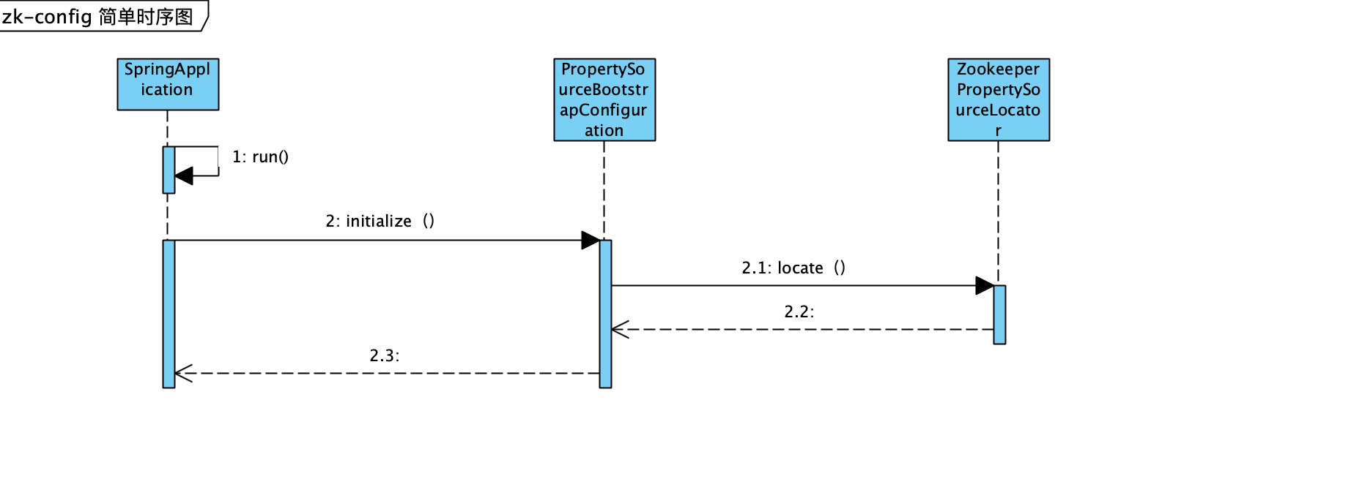
zk-config流程图

Slide 14
zk-config小结
添加配置 spring.factroies
BootstrapConfiguration=\ZookeeperConfigBootstrapConfiguration
zk-config开关打开实例化ZookeeperPropertySourceLocator
Spring boot启动时调用PropertySourceBootstrapConfiguration.initialize
Init调用ZookeeperPropertySourceLocator加载zk配置

Slide 15
二.ConfigWacher

Slide 16
configWacher
EnableAutoConfiguration配置ZookeeperConfigAutoConfiguration
ConfigWatcher 监听节点变化
RefreshEvent
刷新配置
重新绑定配置
LocalPropertySourceLocator.locate()
addConfigFilesToEnvironment()
rebind()
postProcessBeforeInitialization()
SpringApplicationBuilder.run()
initializeBean()

Slide 17
zk-config里面的Spring.factories
# Auto Configuration org.springframework.boot.autoconfigure.EnableAutoConfiguration=\ org.springframework.cloud.zookeeper.config.ZookeeperConfigAutoConfiguration # Bootstrap Configuration org.springframework.cloud.bootstrap.BootstrapConfiguration=\ org.springframework.cloud.zookeeper.config.ZookeeperConfigBootstrapConfiguration

Slide 18
ZookeeperConfigAutoConfiguration
@Configuration @ConditionalOnZookeeperEnabled @ConditionalOnProperty(value = "spring.cloud.zookeeper.config.enabled", matchIfMissing = true) public class ZookeeperConfigAutoConfiguration { @Configuration @ConditionalOnClass(RefreshEndpoint.class) protected static class ZkRefreshConfiguration { @Bean @ConditionalOnProperty(name = "spring.cloud.zookeeper.config.watcher.enabled", matchIfMissing = true) public ConfigWatcher configWatcher(ZookeeperPropertySourceLocator locator, CuratorFramework curator) { return new ConfigWatcher(locator.getContexts(), curator); } } }

Slide 19
ConfigWatcher
@PostConstruct public void start() { if (this.running.compareAndSet(false, true)) { this.caches = new HashMap<>(); for (String context : this.contexts) { if (!context.startsWith(“/”)) { context = “/" + context; } try { TreeCache cache = TreeCache.newBuilder(this.source, context).build(); cache.getListenable().addListener(this); cache.start(); this.caches.put(context, cache); } catch (KeeperException.NoNodeException e) { } catch (Exception e) { log.error("Error initializing listener for context " + context, e); } } } }

Slide 20
ConfigWatcher 监听节点变化
@Override public void childEvent(CuratorFramework client, TreeCacheEvent event) throws Exception { TreeCacheEvent.Type eventType = event.getType(); if (eventType == NODE_ADDED || eventType == NODE_REMOVED || eventType == NODE_UPDATED) { this.publisher.publishEvent(new RefreshEvent(this, event, getEventDesc(event))); } }
监听节点的新增、删除、更新变化之后发送RefreshEvent事件

Slide 21
Refresh – 监听器
@CommonsLog public class RefreshEventListener { private ContextRefresher refresh; private AtomicBoolean ready = new AtomicBoolean(false); public RefreshEventListener(ContextRefresher refresh) { this.refresh = refresh; } @EventListener public void handle(RefreshEvent event) { if (this.ready.get()) { // don't handle events before app is ready log.debug("Event received " + event.getEventDesc()); Set<String> keys = this.refresh.refresh(); log.info("Refresh keys changed: " + keys); } } }

Slide 22
Refresh方法
public synchronized Set<String> refresh() { Map<String, Object> before = extract( this.context.getEnvironment().getPropertySources());
//刷新配置 addConfigFilesToEnvironment(); Set<String> keys = changes(before, extract(this.context.getEnvironment().getPropertySources())).keySet();
//重新绑定配置 this.context.publishEvent(new EnvironmentChangeEvent(keys)); this.scope.refreshAll(); return keys; }

Slide 23
addConfigFilesToEnvironment方法
private void addConfigFilesToEnvironment() { StandardEnvironment environment = copyEnvironment( this.context.getEnvironment()); SpringApplicationBuilder builder = new SpringApplicationBuilder(Empty.class) .bannerMode(Mode.OFF).web(false).environment(environment); builder.application() .setListeners(Arrays.asList(new BootstrapApplicationListener(), new ConfigFileApplicationListener())); ConfigurableApplicationContext capture = builder.run(); MutablePropertySources target = this.context.getEnvironment() .getPropertySources(); target.merge(environment);
}

Slide 24
ConfigurationPropertiesRebinder
public void onApplicationEvent(EnvironmentChangeEvent event) { rebind(); }
public void rebind() { this.errors.clear(); for (String name : this.beans.getBeanNames()) { rebind(name); } }

Slide 25
ConfigurationPropertiesRebinder
public boolean rebind(String name) { Object bean = this.applicationContext.getBean(name); if (AopUtils.isCglibProxy(bean)) { bean = getTargetObject(bean); }
// 初始化之前把新配置绑定 this.binder.postProcessBeforeInitialization(bean, name);
// 重新初始化bean this.applicationContext.getAutowireCapableBeanFactory() .initializeBean(bean, name); return true; }

Slide 26
ConfigWacher – 小结
添加配置 spring.factroies
EnableAutoConfiguration=\ZookeeperConfigAutoConfiguration
监听节点变化之后发送RefreshEvent事件
刷新配置 SpringApplicationBuilder.run()
重新初始化所有bean（绑定新配置属性）
postProcessBeforeInitialization()
initializeBean()

Slide 27
三.解密

Slide 28
Encrypt流程图
SpringApplication.run()
BootstrapConfiguration配置 EncryptPostProcessor
EncryptPostProcessor. postProcessBeforeInitialization()
updateBean()
deCode(key,encryptedValue)

Slide 29
加密配置
security: key: wretched growth,don't indulge
sync.redis.host=gld.redis.cnhz.keruyun.com sync.redis.port=6379 sync.redis.pass=ENC(ktptoj0WmJnTHya28Xvsc07VpfrefxDcBHAhLR9A72NkHXGpookbBG6/n0nVwaXW) sync.redis.timeout=1000
spring.factroies: org.springframework.cloud.bootstrap.BootstrapConfiguration=com.keruyun.infra.encrypt.springboot.EncryptPostProcessor

Slide 30
EncryptPostProcessor
public class EncryptPostProcessor implements BeanPostProcessor { @Autowired private EncryptConfig encryptConfig; public Object postProcessBeforeInitialization(Object bean, String beanName) throws BeansException { if(AopUtils.isAopProxy(bean)) { Object target = bean; if(target != null) { this.updateBean(target); } } else { this.updateBean(bean); } return bean; } }

Slide 31
EncryptPostProcessor
private String deCode(Object bean, Field field, String content) throws IllegalAccessException { String result = content; if(content.startsWith("ENC(") && content.endsWith(")")) { if(this.encryptConfig == null || this.encryptConfig.getKey() == null || this.encryptConfig.getKey().isEmpty()) { logger.error("请配置解密key"); return content; } String opValue1 = content.replace("ENC(", "").replace(")", ""); result = EncryptUtil.decrypt(this.encryptConfig.getKey(), opValue1); logger.debug("deCode before is: " + content + ",after is:" + result); } return result; }

Slide 32
Encrypt – 小结
添加配置 spring.factroies
BootstrapConfiguration =\ EncryptPostProcessor
初始化bean之前执行EncryptPostProcessor. postProcessBeforeInitialization
如果是符合解密的属性，用配置的key解密属性即可

Slide 33
四.local-locator

Slide 34
local-config流程图
SpringApplication.run()
BootstrapConfiguration配置
PropertySourceBootstrapConfiguration. Initialize()
PropertySourceLocator. Locate()
PropertySourceLocator. Locate()
spring.factories
ZookeeperPropertySourceLocator.locate()
LocalPropertySourceLocator.locate()

Slide 35
Local配置信息
# Bootstrap Configuration org.springframework.cloud.bootstrap.BootstrapConfiguration=\ com.keruyun.calm.locator.LocalPropertySourceBootstrapConfig
@Configuration public class LocalPropertySourceBootstrapConfig { @Bean @ConditionalOnMissingBean @ConditionalOnProperty(value = "spring.cloud.zookeeper.enabled",havingValue = "false", matchIfMissing = true) public LocalPropertySourceLocator localPropertySourceLocator() { return new LocalPropertySourceLocator(); } }

Slide 36
LocalPropertySourceLocator
public class LocalPropertySourceLocator implements PropertySourceLocator { @Override public PropertySource<?> locate(Environment environment) { CompositePropertySource composite = new CompositePropertySource(“localProperty”); List<String> fileList = environment.getActiveProfiles(); for (String fileName: fileList) { InputStream inputStream = this.getClass().getClassLoader().getResourceAsStream(fileName + “.properties”); InputStreamResource resource = new InputStreamResource(inputStream); composite.addPropertySource(resourcePropertySource); } return composite; } }

Slide 37
Local locator – 小结
添加配置 spring.factroies
BootstrapConfiguration =\ LocalPropertySourceBootstrapConfig
服务启动的时候调用LocalPropertySourceLocator . locate加载本地配置

Slide 38
四.Spring boot初始化两次

Slide 39
zk-config里面的Spring.factories
# Auto Configuration
// 这个启用configWacher的配置 org.springframework.boot.autoconfigure.EnableAutoConfiguration=\ org.springframework.cloud.zookeeper.config.ZookeeperConfigAutoConfiguration # Bootstrap Configuration
// 这个是启用zk-config的配置 org.springframework.cloud.bootstrap.BootstrapConfiguration=\ org.springframework.cloud.zookeeper.config.ZookeeperConfigBootstrapConfiguration

Slide 40
灵魂几问
spring.factories的相关原理你真的知道吗？
怎么加载（API是什么）
为什么zk-config配置的是BootstrapConfiguration
为什么configWacher配置的是EnableAutoConfiguration
配置为BootstrapConfiguration加载时机是怎么样的
配置为EnableAutoConfiguration加载时机是怎么样的
Spring boot 为什么具有加载外部配置的能力
PropertySourceBootstrapConfiguration实例化时机
ZookeeperConfigBootstrapConfiguration实例化时机
ZookeeperPropertySourceLocator实例化时机

Slide 41
@SpringBootApplication注解
@SpringBootConfiguration
@Configuration java config bean
@EnableAutoConfiguration
自动配置
@ComponentScan
扫描注解bean (eg @service)

Slide 42
Spring.factories
# AutoConfiguration org.springframework.boot.autoconfigure.EnableAutoConfiguration=\ org.springframework.cloud.autoconfigure.ConfigurationPropertiesRebinderAutoConfiguration,\ org.springframework.cloud.autoconfigure.RefreshAutoConfiguration,\ org.springframework.cloud.autoconfigure.RefreshEndpointAutoConfiguration,\ org.springframework.cloud.autoconfigure.LifecycleMvcEndpointAutoConfiguration # Application Listeners org.springframework.context.ApplicationListener=\ org.springframework.cloud.bootstrap.BootstrapApplicationListener,\ org.springframework.cloud.bootstrap.LoggingSystemShutdownListener,\ org.springframework.cloud.context.restart.RestartListener # Bootstrap components org.springframework.cloud.bootstrap.BootstrapConfiguration=\ org.springframework.cloud.bootstrap.config.PropertySourceBootstrapConfiguration,\ org.springframework.cloud.bootstrap.encrypt.EncryptionBootstrapConfiguration,\ org.springframework.cloud.autoconfigure.ConfigurationPropertiesRebinderAutoConfiguration,\ org.springframework.boot.autoconfigure.PropertyPlaceholderAutoConfiguration

Slide 43
Spring.factories怎么加载
SpringFactoriesLoader.loadFactoryNames(Class<?> factoryClass, ClassLoader classLoader)
ClassLoader classLoader = Thread.currentThread().getContextClassLoader(); Set<String> names = new LinkedHashSet<String>( SpringFactoriesLoader.loadFactoryNames(SpringApplicationRunListener.class classLoader));
ClassLoader classLoader = Thread.currentThread().getContextClassLoader(); Set<String> names = new LinkedHashSet<String>( SpringFactoriesLoader.loadFactoryNames(BootstrapConfiguration.class classLoader));

Slide 44
自动配置
SpringApplication.run()
@EnableAutoConfiguration
EnableAutoConfigurationImportSelector
SpringFactoriesLoader. loadFactoryNames()
spring.factories
zk-config
eureka
robbin
….

Slide 45
spring boot 初始化流程图
SpringApplication.run()
加载配置为BootstrapConfiguration的类作为parentBeanFactory
SpringApplication.run()
AbstractApplicationContext.refresh()
ConfigFileApplicationListener 加载本地配置
PropertySourceBootstrapConfiguration 加载外部配置
由第一次初始化创建
AbstractApplicationContext.refresh()
CalmRouterTradeBootstrap
Xml bean
Java config bean
AutoConfiguration bean
@ImportResource
@ComponentScan
@EnableAutoConfiguration

Slide 46
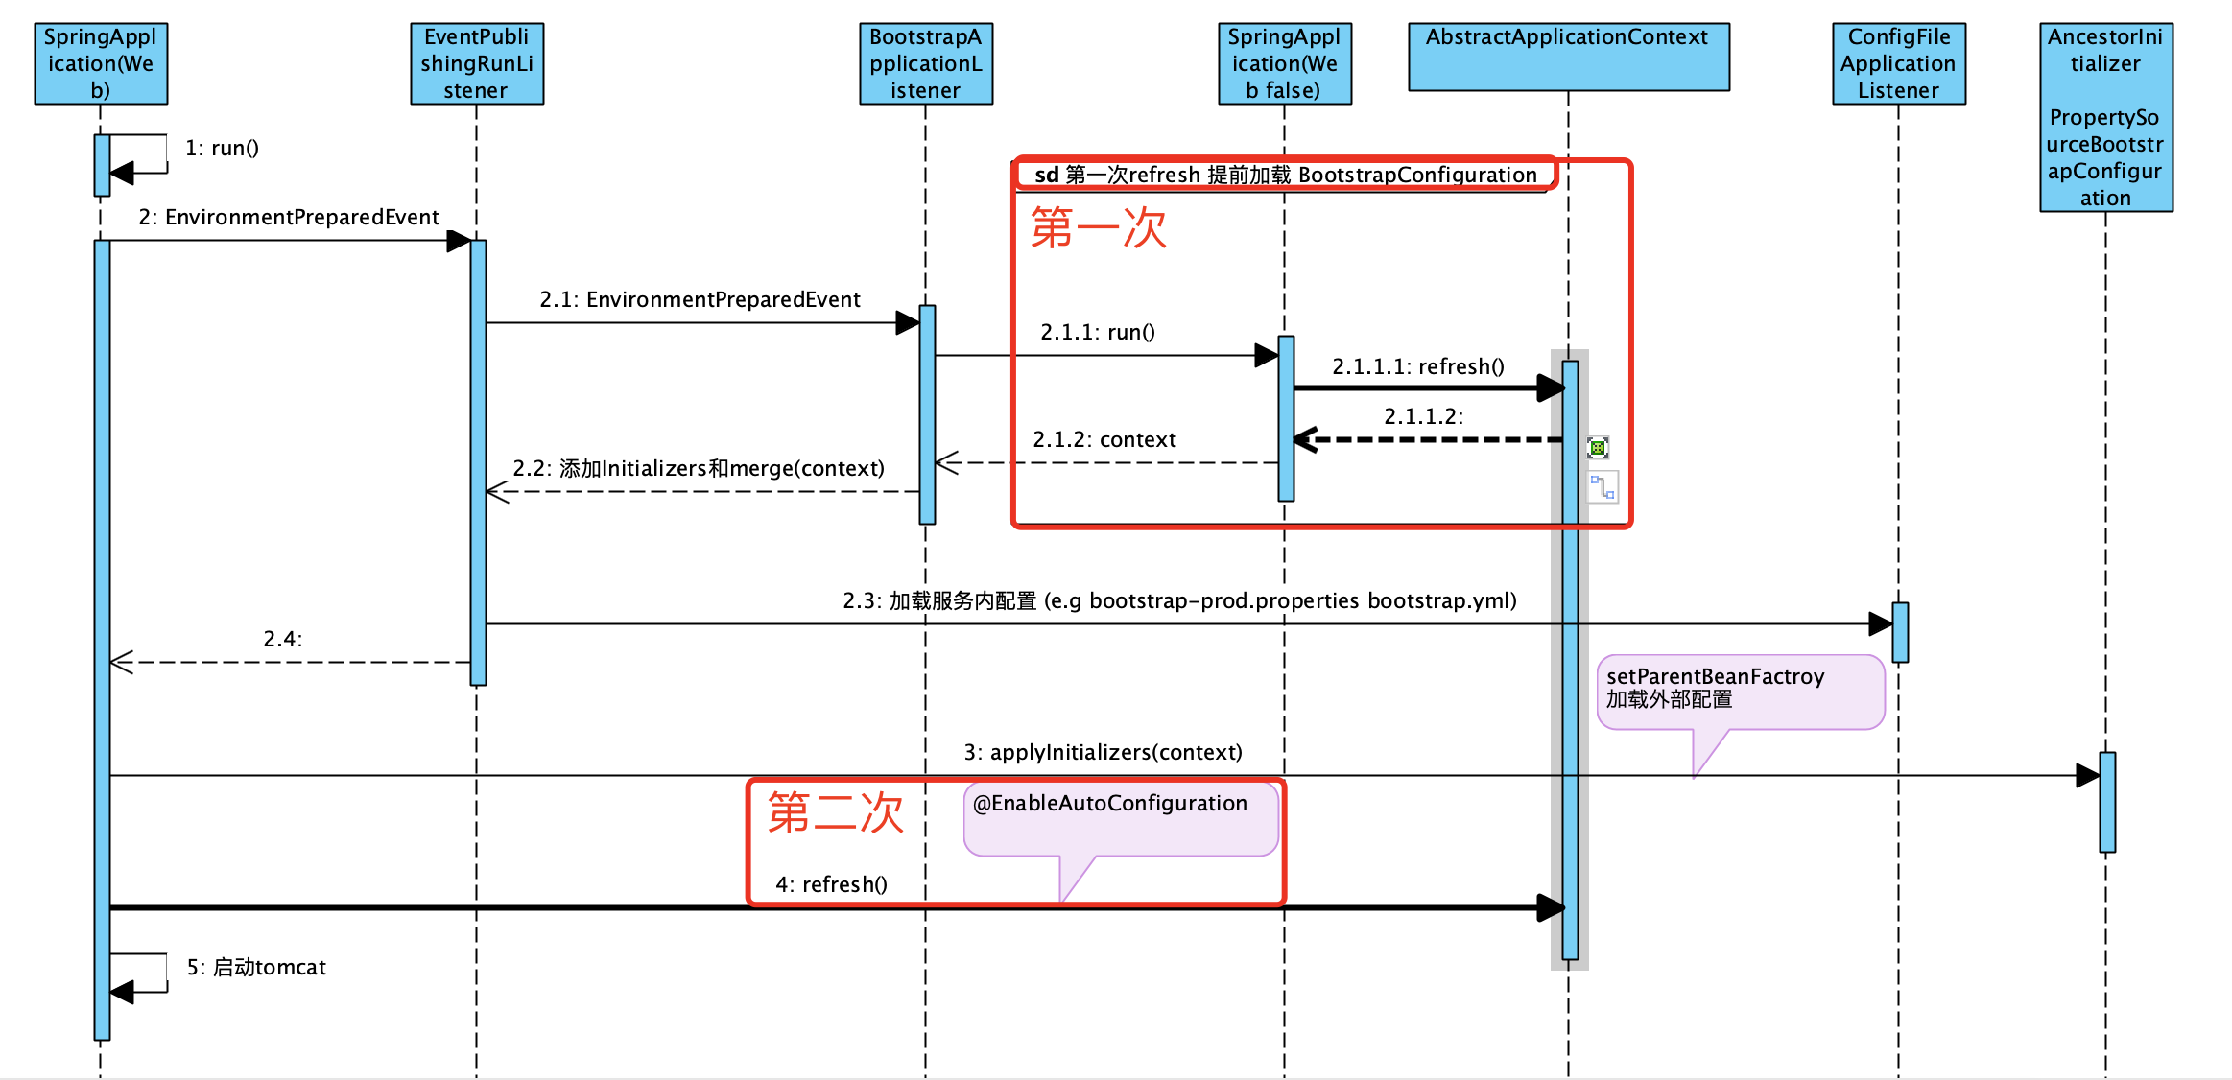
Spring boot 启动时序图

Slide 47
时序图说明
第一次初始化提前实例化所有的BootstrapConfiguration配置类
把PropertySourceBootstrapConfiguration添加到当前的Initializer中
把第一次初始化的beanFactroy作为当前beanFactroy的parentBeanFactory
加载本服务内配置 eg bootstrap-prod.properties
遍历所有Initializer调用其initialize()方法
PropertySourceBootstrapConfiguration. initialize() 加载外部配置
第二次初始化所有服务内自定义的bean
Xml bean [@ImportResource(value = {"applicationContext-root.xml"})]
Java config bean [@ComponentScan(basePackages = "com.keruyun")]
AutoConfiguration bean [@EnableAutoConfiguration]

Slide 48
终章
知道zk配置中心的原理、动态感应配置变更、加解密、怎么加载本地配置
spring.factories的原理 怎么加载 不同配置的加载时机
spring boot 为什么具有加载外部配置的能力
spring boot 为什么需要初始化两遍

Slide 49
QA

Slide 50
THANK YOU

